Slide 1
**Bengaluru Food Delivery Data Analysis** USING PYTHON

Slide 2
LIBRARIES USED
Pandas
Numpy
Matplotlib
seaborn

Slide 3
Objective
Analyze customer behavior, delivery performance, and business optimization strategies for food delivery in Bengaluru.

Slide 4
🔍 Key Insights
**Customer Trends**: Identified repeat customers, high LTV users, and peak order times.
- **Cuisine & Order Patterns**: Determined top cuisines and optimized restaurant onboarding.
-
**Payment Preferences**: Found UPI as the dominant method, guiding promo strategies.
-
**Delivery Performance**: Analyzed delays, cancellations, and peak-hour bottlenecks.
-
**Customer Satisfaction**: Linked ratings and tipping behavior to delivery metrics.

Slide 5
📈 Business Impact
Optimized pricing, promotions, and logistics to
improve customer retention and operational
efficiency.

Slide 6
IMPORTING THE NECESSARY LIBRARIES
import pandas as pd
import numpy as np
import matplotlib.pyplot as plt
import seaborn as sns
import warnings
warnings.filterwarnings('ignore')

Slide 7
READING THE CSV FILE
df=pd.read_csv(r"C:\Users\chait\Downloads\customer_orders - customer_orders.csv")

Slide 8
Order_ID | Order_Date | Customer_ID | Customer_Age | Customer_Gender | Payment_Method | Restaurant_ID | Cuisine_Served | Total_Items | Order_Amount | Discount_Applied | Order_Time | Delivery_Partner_ID | Delivery_Time | Delivery_Time_Minutes | Distance_KM | Delivery Charge | Delivery_Status | Delivery_Rating | Customer_Rating | Final_Price | Tip_Amount
O00001 | 2024-02-24 | C5527 | 20 | Female | UPI Wallet | R026 | Biryani | 1 | 257 | 0 | 2024-02-24 01:55:00 | D559 | 2024-02-24 02:21:00 | 26 | 2.2 | 37.9 | Delivered | 3.9 | 4.6 | 294.9 | 0
O00002 | 2024-01-16 | C9077 | 36 | Female | UPI Wallet | R064 | South Indian | 1 | 168 | 36.3 | 2024-01-16 13:51:00 | D796 | 2024-01-16 14:12:00 | 21 | 3.1 | 20.2 | Delivered | 4.6 | 4.9 | 151.9 | 0
O00003 | 2024-02-08 | C9645 | 18 | Female | UPI Wallet | R041 | South Indian | 2 | 300 | 51.71 | 2024-02-08 09:39:00 | D689 | 2024-02-08 10:34:00 | 55 | 6.3 | 23.3 | Delivered | 4.6 | 3.7 | 271.59 | 0
O00004 | 2024-01-25 | C3230 | 35 | Female | Credit Card | R011 | Street Food | 2 | 360 | 39.72 | 2024-01-25 10:29:00 | D945 | 2024-01-25 10:55:00 | 26 | 6.9 | 34.3 | Delivered | 3.3 | 3.7 | 354.58 | 0
O00005 | 2024-02-25 | C7429 | 30 | Female | Cash on Delivery | R076 | Mexican | 2 | 626 | 0 | 2024-02-25 20:48:00 | D733 | 2024-02-25 22:04:00 | 76 | 9.1 | 24.9 | Delivered | 3.2 | 3.3 | 650.9 | 0
O00006 | 2024-01-07 | C3579 | 28 | Male | Credit Card | R055 | South Indian | 1 | 141 | 14.24 | 2024-01-07 19:58:00 | D699 | 2024-01-07 20:43:00 | 45 | 7 | 51.3 | Delivered | 3.6 | 4.4 | 178.06 | 0
O00007 | 2024-01-26 | C1624 | 38 | Female | Debit Card | R084 | Desserts | 1 | 209 | 19.35 | 2024-01-26 02:03:00 | D540 | 2024-01-26 02:53:00 | 50 | 6.6 | 45 | Delivered | 3.7 | 3.6 | 234.65 | 0

Slide 9
**Question** How many customers place multiple orders?
#count the number of orders per customers
customer_order_counts=df["Customer_ID"].value_counts()
#Filter customers who have placed more than 1 order
multiple_orders=customer_order_counts[customer_order_counts>1]
#get the number of such customers
num_customers_multiple_orders=len(multiple_orders)
print("number of customers who placed multiple orders:",num_customers_multiple_orders)
OUTPUT-number of customers who placed multiple orders: 8998

Slide 10
**Question** What percentage of customers are repeat buyers?
#count orders per customer
customer_order_counts=df["Customer_ID"].value_counts()
#total unique customers
total_customers=len(customer_order_counts)
#repeat buyers(more than 1 order)
repeat_buyers=customer_order_counts[customer_order_counts>1]
#number of repeat buyers
num_repeat_buyers=len(repeat_buyers)
#percentage of repeat buyers
repeat_buyers_percentage=(num_repeat_buyers/total_customers)*100
print(f"percentage of customers who are repeat buyers:{repeat_buyers_percentage:.2f}%")
OUTPUT
percentage of customers who are repeat buyers:99.98%

Slide 11
**Question** How does customer rating impact repeat purchases?
repeat_customers = df[df["Customer_ID"].isin(customer_order_counts[customer_order_counts > 1].index)]
one_time_customers = df[df["Customer_ID"].isin(customer_order_counts[customer_order_counts == 1].index)]
repeat_avg_rating = repeat_customers["Customer_Rating"].mean()
one_time_avg_rating = one_time_customers["Customer_Rating"].mean()
print(f"Average rating for repeat customers: {repeat_avg_rating:.2f}")
print(f"Average rating for one-time customers: {one_time_avg_rating:.2f}")
OUTPUT-Average rating for repeat customers: 4.00
Average rating for one-time customers: 4.60

Slide 12
**Question** Which time slots see the highest number of repeat orders?
# Extract time slots from 'Order_Time'
df["Hour"] = pd.to_datetime(df["Order_Time"]).dt.hour
df["Time_Slot"] = pd.cut(df["Hour"], bins=[0, 6, 12, 16, 20, 24], labels=["Late Night", "Morning", "Afternoon", "Evening", "Night"], right=False)
# Find most common time slot for repeat customers
repeat_order_time = df["Time_Slot"].value_counts(normalize=True) * 100
print(repeat_order_time)
OUTPUT-Time_Slot Night 26.767
Afternoon 25.065
Morning 24.864
Late Night 15.016
Evening 8.288 Name: proportion, dtype: float64

Slide 13
**Question** What is the average order value (AOV) across different cuisines?
# Calculate Average Order Value (AOV) per cuisine
cuisine_aov = df.groupby("Cuisine_Served")["Final_Price"].mean().reset_index()
# Sort by AOV in descending order
cuisine_aov = cuisine_aov.sort_values(by="Final_Price", ascending=False)
print(cuisine_aov)
OUTPUT Cuisine_Served Final_Price
6 Japanese 682.701416 9 North Indian 625.034380 10 Pizza 583.461798 7 Mediterranean 515.751133 0 Bengali 507.190418 2 Chinese 466.515173 8 Mexican 455.635814 5 Healthy 439.403750 4 Fast Food 375.998969 11 South Indian 322.115582 1 Biryani 319.235539 12 Street Food 307.909911 3 Desserts 252.766048

Slide 14
**Question** Which cuisines generate the highest revenue?
# Total revenue by cuisine
revenue_by_cuisine = df.groupby("Cuisine_Served")["Final_Price"].sum().sort_values(ascending=False)
print(revenue_by_cuisine)
OUTPUT
Cuisine_Served
North Indian 10628084.59
South Indian 7444735.33
Pizza 6432082.86
Biryani 5433708.11
Chinese 3231084.09
Street Food 1838530.08

Slide 15
**Question** What is the average delivery time per cuisine?
# Average delivery time by cuisine
avg_delivery_time = df.groupby("Cuisine_Served")["Delivery_Time_Minutes"].mean().sort_values()
print(avg_delivery_time)
OUTPUT
Cuisine_Served
Street Food 37.637883
Fast Food 37.736093
Desserts 41.524888
South Indian 45.235082
Healthy 47.915301
Pizza 48.207316
North Indian 51.508134

Slide 16
**Question** Which cuisines have the highest order frequency?
# Count number of orders per cuisine
cuisine_order_freq = df["Cuisine_Served"].value_counts().reset_index()
cuisine_order_freq.columns = ["Cuisine_Served", "Order_Count"]
print(cuisine_order_freq)
OUTPUT
Cuisine_Served Order_Count
0 South Indian 23112
1 Biryani 17021
2 North Indian 17004
3 Pizza 11024
4 Chinese 6926
5 Street Food 5971

Slide 17
**Question** How does discounting impact the final revenue?
# Calculate total revenue before and after discounts
total_order_amount = df["Order_Amount"].sum()
total_final_price = df["Final_Price"].sum()
discount_impact = (total_order_amount - total_final_price) / total_order_amount * 100
print(f"Overall discount impact: {discount_impact:.2f}%")
OUTPUT
Overall discount impact: 5.75%

Slide 18
**Question** Do customers who tip have higher ratings compared to those who don’t?
# Compare average rating for customers who tip vs. who don’t
tippers = df[df["Tip_Amount"] > 0]["Customer_Rating"].mean()
non_tippers = df[df["Tip_Amount"] == 0]["Customer_Rating"].mean()
print(f"Average rating from tippers: {tippers:.2f}")
print(f"Average rating from non-tippers: {non_tippers:.2f}")
OUTPUT
Average rating from tippers: 3.98 Average rating from non-tippers: 4.00

Slide 19
**Question** Which time slots experience the most delays in delivery?
# Count delayed orders per time slot
delayed_orders = df[df["Delivery_Status"] == "Delayed"]
delays_by_time_slot = delayed_orders["Order_Time"].dt.hour.value_counts().sort_index()
print(delays_by_time_slot)
OUTPUT
Order_Time
0 254
1 252
2 241
7 289
8 312
9 324
10 305

Slide 20
**Question** Which customer segment generates the highest revenue? hint make the customer age in a group
# Calculate total spending per customer segment
customer_segments = df.groupby(pd.cut(df["Customer_Age"], bins=[18, 25, 35, 50, 100]
, labels=["18-25", "26-35", "36-50", "50+"]))["Final_Price"].sum()
print(customer_segments)
OUTPUT
Customer_Age
18-25 9017734.76
26-35 15779749.15
36-50 11092739.38
50+ 761111.07
Name: Final_Price, dtype: float64

Slide 21
**Question** Do older customers tip more than younger ones?
# Average tip by age group
tips_by_age = df.groupby(pd.cut(df["Customer_Age"],
bins=[18, 25, 35, 50, 100],
labels=["18-25", "26-35", "36-50", "50+"]))["Tip_Amount"].mean()
print(tips_by_age)
OUTPUT
Customer_Age
18-25 0.663652
26-35 0.657470
36-50 0.655047
50+ 0.588562
Name: Tip_Amount, dtype: float64

Slide 22
**Question** How does customer rating affect repeat orders?
# Count repeat orders by customers who gave high vs. low ratings
repeat_customers = df.groupby("Customer_ID")["Order_ID"].count()
low_rating_customers = df[df["Customer_Rating"] < 3]["Customer_ID"].nunique()
high_rating_customers = df[df["Customer_Rating"] >= 4]["Customer_ID"].nunique()
print(f"Repeat customers with low ratings: {low_rating_customers}")
print(f"Repeat customers with high ratings: {high_rating_customers}")
OUTPUT
Repeat customers with low ratings: 0
Repeat customers with high ratings: 8950

Slide 23
**Question** What payment methods are preferred by high-spending customers?
# Total spending by payment method
spending_by_payment = df.groupby("Payment_Method")["Final_Price"].sum()
print(spending_by_payment)
OUTPUT
Payment_Method
Cash on Delivery 4322127.25
Credit Card 12697051.86
Debit Card 6419469.10
UPI Wallet 19016884.24
Name: Final_Price, dtype: float64

Slide 24
**Question** What is the average order value of new vs. returning customers?
# Identify new vs. returning customers
customer_order_counts = df.groupby("Customer_ID")["Order_ID"].count()
new_customers = df[df["Customer_ID"].isin(customer_order_counts[customer_order_counts == 1].index)]
returning_customers = df[df["Customer_ID"].isin(customer_order_counts[customer_order_counts > 1].index)]
# Calculate average order value
avg_order_value_new = new_customers["Final_Price"].mean()
avg_order_value_returning = returning_customers["Final_Price"].mean()
print(f"Average order value for new customers: {avg_order_value_new:.2f}")
print(f"Average order value for returning customers: {avg_order_value_returning:.2f}")
OUTPUT
Average order value for new customers: 422.62 Average order value for returning customers: 424.56

Slide 25
**Question :** How do the number of successfully delivered orders and the total order value evolve over time, particularly on a monthly basis?
df['Month'] = df['Order_Date'].dt.month_name()
monthly_data =
df[df['Delivery_Status']=="Delivered"].groupby('Month').agg(
total_orders=('Order_ID', 'count'),
total_order_value=('Order_Amount', 'sum')
).reset_index()
Continuation in the next slide

Slide 26
# Convert total_order_value to Lakhs (1 Lakh = 100,000)
monthly_data['total_order_value_lakh’] =
monthly_data['total_order_value'] / 100

Slide 27
# Plotting using horizontal side-by-side bar plot
fig, ax = plt.subplots(figsize=(10, 4))
# Set the position for the bars (side by side)
bar_width = 0.2
index = monthly_data['Month'].astype(str)
# Plot Total Orders (1st bar) and Total Order Value (2nd bar) side by side horizontally
bars1 = ax.barh(index, monthly_data['total_orders'], bar_width, label='Total Orders', color='skyblue')
bars2 = ax.barh(index, monthly_data['total_order_value_lakh'], bar_width, label='Total Order Value (in Cr)', color='orange', left=monthly_data['total_orders'])
# Adding annotations for each bar segment
for rect in bars1:
width = rect.get_width()
ax.text(width + 500, rect.get_y() + rect.get_height() / 2,
str(int(width)), ha='right', va='center', color='black', fontsize=10)
for rect in bars2:
width = rect.get_width()
ax.text(width + 500, rect.get_y() + rect.get_height() / 2,
f'{width/100000:.2f} Cr', ha='left', va='bottom', color='black', fontsize=10)
# Adding titles and labels
ax.set_xlabel('Count / Value')
ax.set_ylabel('Month')
ax.set_title('Monthly Order Trends with Horizontal Side-by-Side Bar Plot')
ax.legend()
plt.tight_layout() # To ensure everything fits nicely
plt.show()

Slide 28
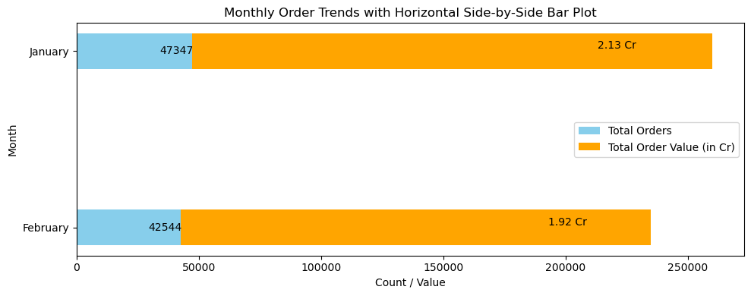

Slide 29
**Question :** How do customers of different age groups and genders behave in terms of order frequency and the amount spent?
Solution in the next slide

Slide 30
# Grouping by Age and Gender
age_bins = [18, 25, 35, 45, 55, 65, 100] # Define age groups
age_labels = ['18-25', '26-35', '36-45', '46-55', '56-65', '66+']
df['Age_Group'] = pd.cut(df['Customer_Age'], bins=age_bins, labels=age_labels, right=False)
# Group by Age_Group and Gender to calculate Order Frequency and Average Order Amount
age_gender_group = df.groupby(['Age_Group', 'Customer_Gender']).agg(
order_frequency=('Order_Amount', 'count'), # Number of orders per group
avg_order_amount=('Order_Amount', 'mean') # Average order value per group
).reset_index()
# Plotting
fig, ax = plt.subplots(1, 2, figsize=(14, 6))
# Plot Order Frequency by Age Group and Gender
sns.barplot(x='Age_Group', y='order_frequency', hue='Customer_Gender', data=age_gender_group, ax=ax[0])
ax[0].set_title('Order Frequency by Age Group and Gender')
ax[0].set_xlabel('Age Group')
ax[0].set_ylabel('Number of Orders')
# Plot Average Order Amount by Age Group and Gender
sns.barplot(x='Age_Group', y='avg_order_amount', hue='Customer_Gender', data=age_gender_group, ax=ax[1])
ax[1].set_title('Average Order Amount by Age Group and Gender')
ax[1].set_xlabel('Age Group')
ax[1].set_ylabel('Average Order Amount')
plt.tight_layout()
plt.show()

Slide 31
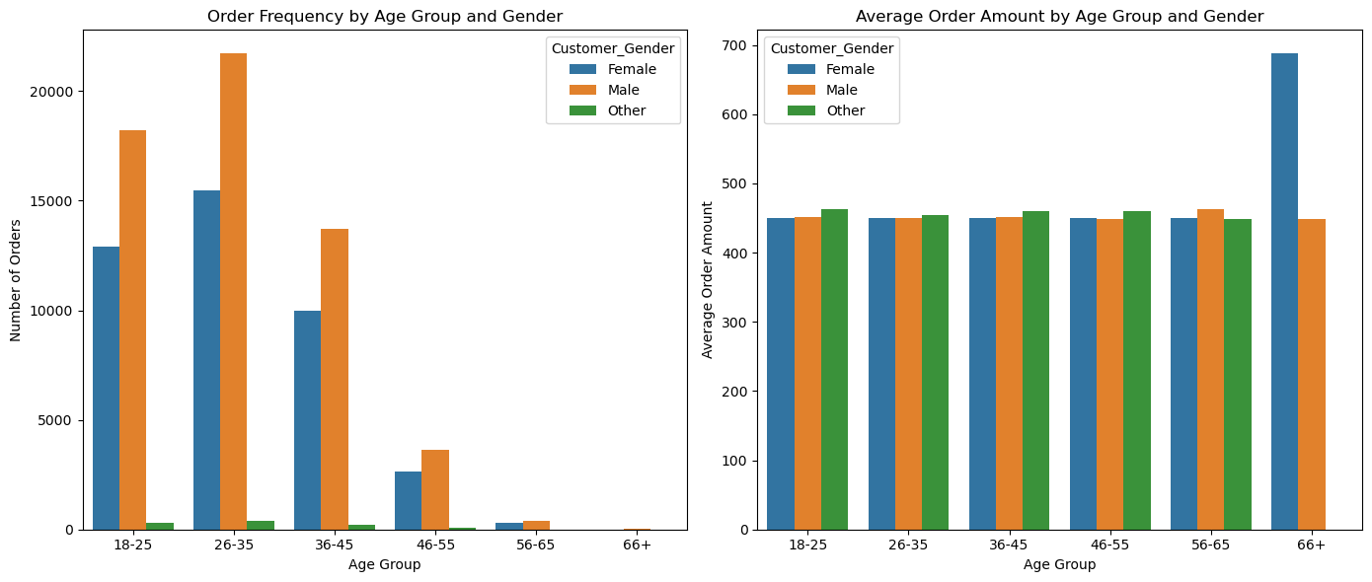

Slide 32
**Question:** Which restaurants receive the highest volume of orders, and which one has the highest average order value?
restaurant_performance = df.groupby('Restaurant_ID').agg(
total_orders=('Order_ID', 'count'),
avg_order_value=('Order_Amount', 'mean'),
total_revenue=('Order_Amount', 'sum')
).reset_index()
# Sorting the restaurants by total orders and average order value
top_restaurants_by_orders = restaurant_performance.sort_values(by='total_orders', ascending=False).head(10)
top_restaurants_by_avg_order_value = restaurant_performance.sort_values(by='avg_order_value', ascending=False).head(10)
# Plotting the performance metrics
fig, ax = plt.subplots(1, 2, figsize=(14, 6))
# Plotting total orders
sns.barplot(x='total_orders', y='Restaurant_ID', data=top_restaurants_by_orders, ax=ax[0])
ax[0].set_title('Top 10 Restaurants by Total Orders')
ax[0].set_xlabel('Total Orders')
ax[0].set_ylabel('Restaurant ID')
# Plotting average order value
sns.barplot(x='avg_order_value', y='Restaurant_ID', data=top_restaurants_by_avg_order_value, ax=ax[1])
ax[1].set_title('Top 10 Restaurants by Average Order Value')
ax[1].set_xlabel('Average Order Value')
ax[1].set_ylabel('Restaurant ID')
plt.tight_layout()
plt.show()

Slide 33
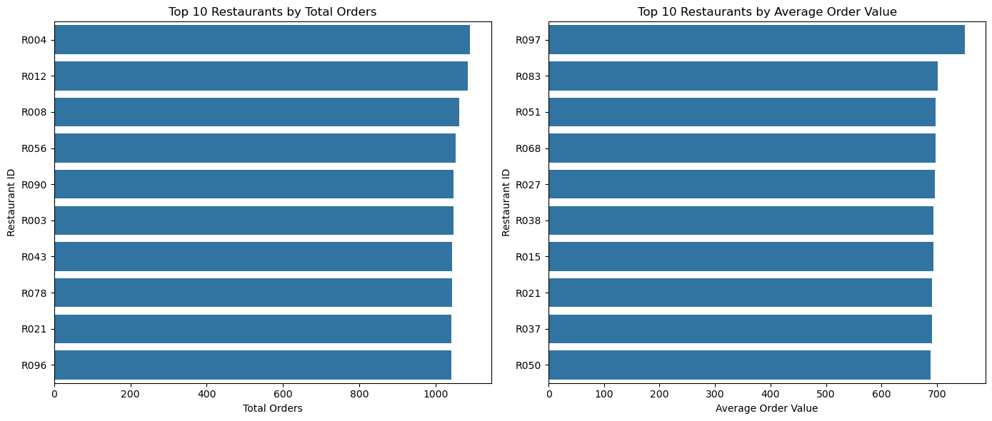

Slide 34
**Question:** Which cuisine types are ordered the most, and which generate the highest total revenue?
cuisine_performance = df.groupby('Cuisine_Served').agg(
total_orders=('Order_ID', 'count'),
total_revenue=('Order_Amount', 'sum'),
avg_order_value=('Order_Amount', 'mean')
).reset_index()
# Sorting the cuisines by total orders and total revenue
top_cuisines_by_orders = cuisine_performance.sort_values(by='total_orders', ascending=False)
top_cuisines_by_revenue = cuisine_performance.sort_values(by='total_revenue', ascending=False)
# Plotting the performance metrics
fig, ax = plt.subplots(1, 2, figsize=(14, 6))
# Plotting total orders
sns.barplot(x='total_orders', y='Cuisine_Served', data=top_cuisines_by_orders, ax=ax[0])
ax[0].set_title('Top Cuisines by Total Orders')
ax[0].set_xlabel('Total Orders')
ax[0].set_ylabel('Cuisine Served')
# Plotting total revenue
sns.barplot(x='total_revenue', y='Cuisine_Served', data=top_cuisines_by_revenue, ax=ax[1])
ax[1].set_title('Top Cuisines by Total Revenue')
ax[1].set_xlabel('Total Revenue')
ax[1].set_ylabel('Cuisine Served')
plt.tight_layout()
plt.show()

Slide 35
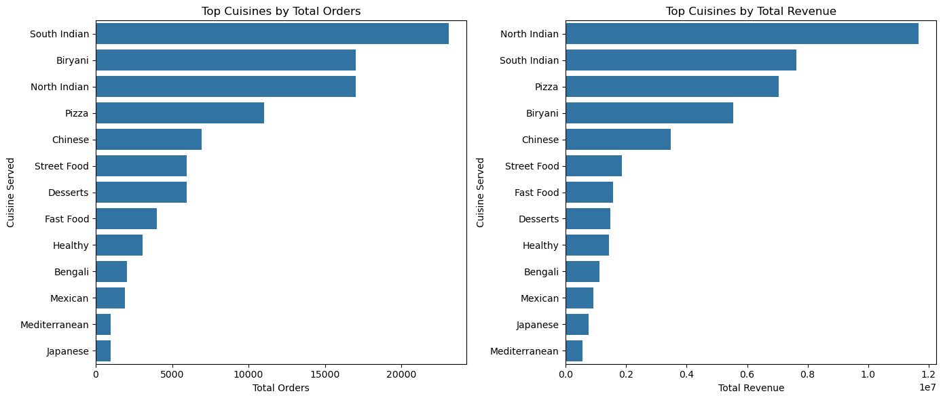

Slide 36
**Question:** Which delivery partner consistently provides the fastest delivery times?
delivery_partner_performance = df.groupby('Delivery_Partner_ID').agg(
avg_delivery_time=('Delivery_Time_Minutes', 'mean'),
avg_delivery_rating=('Delivery_Rating', 'mean'),
avg_customer_rating=('Customer_Rating', 'mean')
).reset_index()
# Sorting the delivery partners by average delivery time
fastest_delivery_partners = delivery_partner_performance.sort_values(by='avg_delivery_time').head(10)
# Plotting the performance metrics
fig, ax = plt.subplots(1, 3, figsize=(18, 6))
# Plotting average delivery time
sns.barplot(x='avg_delivery_time', y='Delivery_Partner_ID', data=fastest_delivery_partners, ax=ax[0])
ax[0].set_title('Top 10 Fastest Delivery Partners')
ax[0].set_xlabel('Average Delivery Time (Minutes)')
ax[0].set_ylabel('Delivery Partner ID')
# Plotting average delivery rating
sns.barplot(x='avg_delivery_rating', y='Delivery_Partner_ID', data=fastest_delivery_partners, ax=ax[1])
ax[1].set_title('Average Delivery Rating of Fastest Partners')
ax[1].set_xlabel('Average Delivery Rating')
ax[1].set_ylabel('Delivery Partner ID')
# Plotting average customer rating
sns.barplot(x='avg_customer_rating', y='Delivery_Partner_ID', data=fastest_delivery_partners, ax=ax[2])
ax[2].set_title('Average Customer Rating of Fastest Partners')
ax[2].set_xlabel('Average Customer Rating')
ax[2].set_ylabel('Delivery Partner ID')
plt.tight_layout()
plt.show()

Slide 37
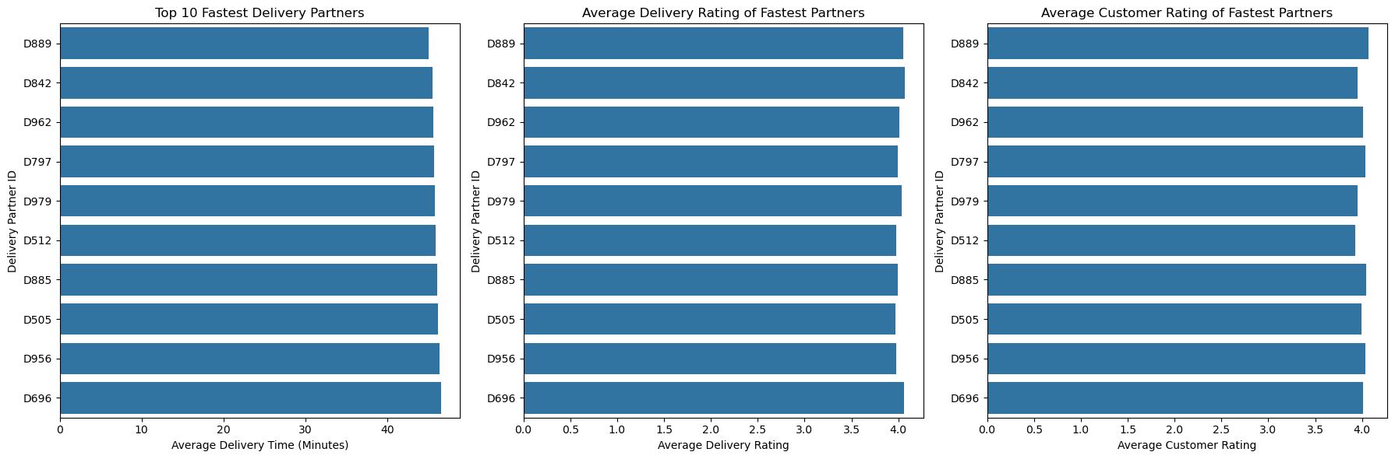

Slide 38
**Question:** How does the application of a discount affect the final price paid by customers?
df['Discount_Applied_Flag'] = df['Discount_Applied'] > 0
# Group the data by Discount_Applied_Flag and calculate the average Final_Price
discount_impact = df.groupby('Discount_Applied_Flag').agg(
avg_final_price=('Final_Price', 'mean')
).reset_index()
# Rename the Discount_Applied_Flag values for better readability
discount_impact['Discount_Applied_Flag'] = discount_impact['Discount_Applied_Flag'].map({True: 'Discount Applied', False: 'No Discount'})
# Plotting the average final price for orders with and without discounts
plt.figure(figsize=(8, 6))
sns.barplot(x='Discount_Applied_Flag', y='avg_final_price', data=discount_impact, palette='viridis')
plt.title('Average Final Price by Discount Application')
plt.xlabel('Discount Application')
plt.ylabel('Average Final Price')
plt.show()

Slide 39
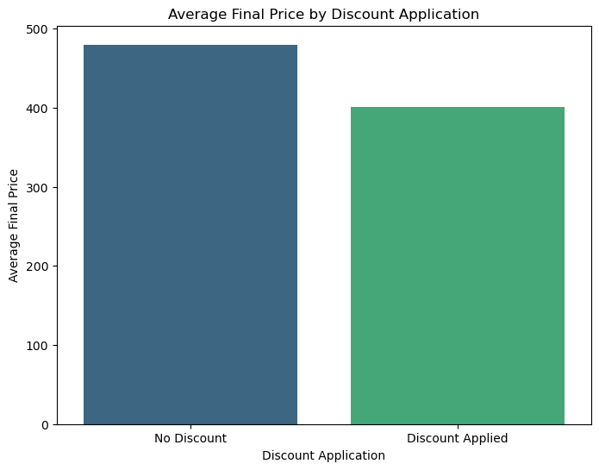

Slide 40
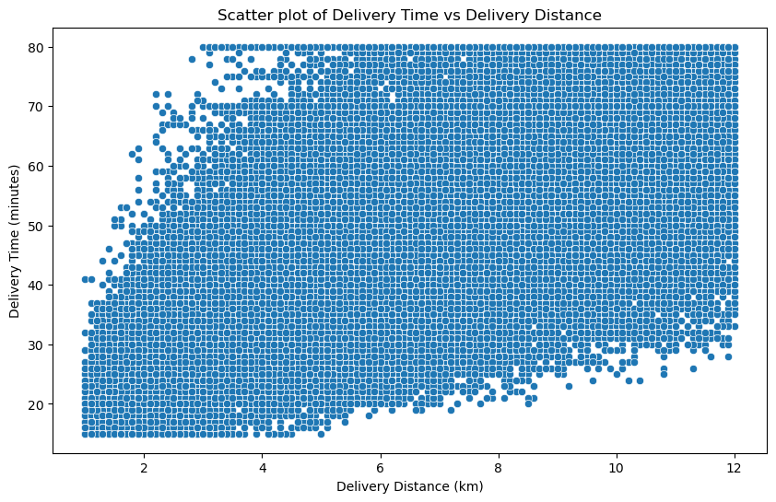
**Question:** Is there a direct correlation between delivery time (in minutes) and the delivery distance (in kilometers)?
# Scatter plot
plt.figure(figsize=(10, 6))
sns.scatterplot(x='Distance_KM', y='Delivery_Time_Minutes', data=df)
plt.title('Scatter plot of Delivery Time vs Delivery Distance')
plt.xlabel('Delivery Distance (km)')
plt.ylabel('Delivery Time (minutes)')
plt.show()

Slide 41
df[['Delivery_Time_Minutes','Distance_KM']].corr()
Delivery_Time_Minutes | Distance_KM
Delivery_Time_Minutes | 1.000000 | 0.771836
Distance_KM | 0.771836 | 1.000000

Slide 42
**Question** Do customers who receive discounts tend to rate their experience better or worse than those who don't?
# Create two groups based on Discount_Applied
discounted_orders = df[df['Discount_Applied'] > 0]
non_discounted_orders = df[df['Discount_Applied'] == 0]
# Calculate the average customer ratings for both groups
avg_rating_discounted = discounted_orders['Customer_Rating'].mean()
avg_rating_non_discounted = non_discounted_orders['Customer_Rating'].mean()
OUTPUT
3.997818470075307 4.003378579952267
print(avg_rating_discounted, avg_rating_non_discounted)

Slide 43
**Question** What percentage of orders are cancelled each month, and how has this percentage changed over time?
df['Cancelled_Flag'] = df['Delivery_Status'] == 'Cancelled'
# Group by Month and calculate the percentage of cancelled orders
monthly_cancellations = df.groupby('Month').agg(
total_orders=('Order_ID', 'count'),
cancelled_orders=('Cancelled_Flag', 'sum')
).reset_index()
monthly_cancellations['cancelled_percentage'] = (monthly_cancellations['cancelled_orders'] / monthly_cancellations['total_orders']) * 100
# Sort by Month for better visualization
month_order = ['January', 'February']
monthly_cancellations['Month'] = pd.Categorical(monthly_cancellations['Month'], categories=month_order, ordered=True)
monthly_cancellations = monthly_cancellations.sort_values('Month')

Slide 44
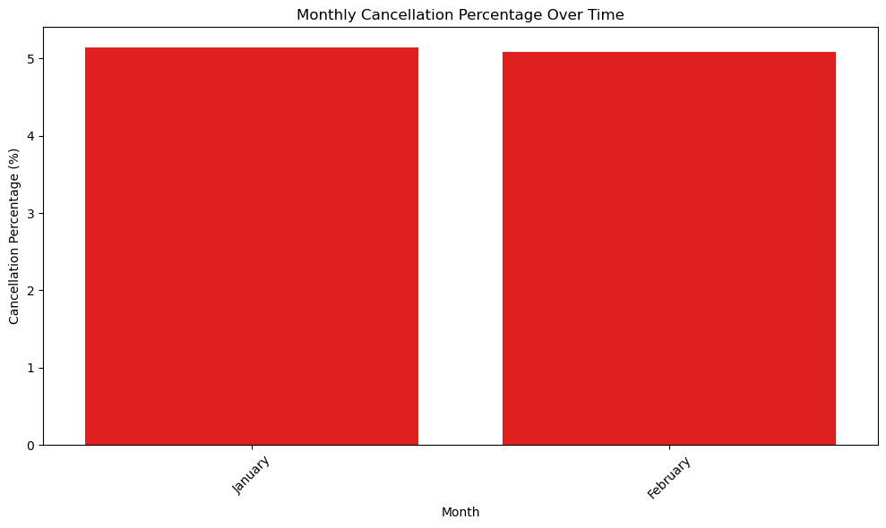
# Plotting the trend
plt.figure(figsize=(10, 6))
sns.barplot(x='Month', y='cancelled_percentage', data=monthly_cancellations, color='red')
plt.title('Monthly Cancellation Percentage Over Time')
plt.xlabel('Month')
plt.ylabel('Cancellation Percentage (%)')
plt.xticks(rotation=45)
plt.tight_layout()
plt.show()

Slide 45
**Question** What is the correlation between order amount and customer rating?
# Correlation between order amount and customer rating
correlation = df["Final_Price"].corr(df["Customer_Rating"])
print(f"Correlation between order amount and customer rating: {correlation:.2f}")
OUTPUT
Correlation between order amount and customer rating: 0.00

Slide 46
**Question** What is the probability that an order gets delayed beyond 45 minutes?
# Probability of delay beyond 45 minutes
delay_probability = (df["Delivery_Time_Minutes"] > 45).mean()
print(f"Probability of delay beyond 45 minutes: {delay_probability:.2%}")
Probability of delay beyond 45 minutes: 52.12%

